Slide 1
Introduction to Programming with Python
Vineet Bansal
Research Software Engineer, Center for Statistics & Machine Learning
vineetb@princeton.edu
August 20-24, 2018

Slide 2
Tuples
Use ‘(‘ and ‘)’ instead of ‘[‘ and ‘]’
>>> t = (1, 2, 3)
Immutable version of List.
Indexing/Slicing works the same
Cannot insert/delete/append once created
Fast! (items stored at consecutive memory locations)

Slide 3
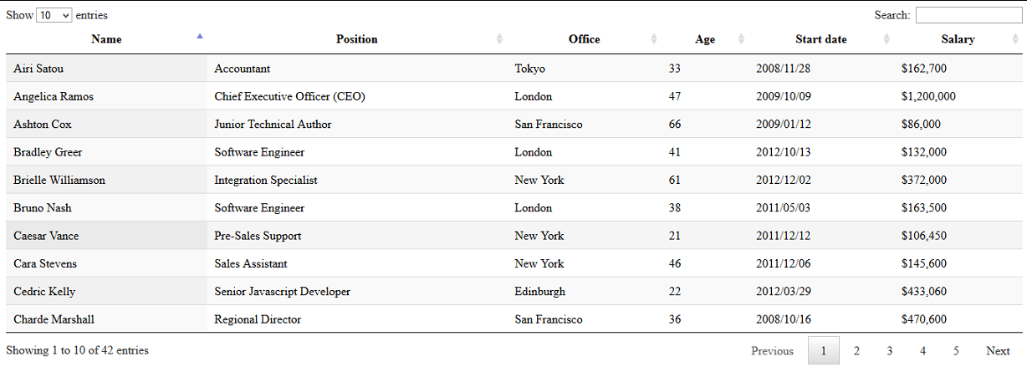
Tuples
Why do we need tuples at all?
Useful when a sequence of items should not be altered.
Each row is a tuple
We have a list of
rows

Slide 4
Tuple Packing/Unpacking
The ‘(‘ and ‘)’ can be omitted during assignment. Python ‘packs’ the individual items into a tuple.
>>> t = 1, 2, 3
>>> type(t)
<class ‘tuple’>
Similarly, tuple unpacking is a common way of assigning multiple variables in one line:
>>> a, b, c = 97, 98, 99
>>> b
98

Slide 5
Tuple Packing/Unpacking
This allows us to write the world’s shortest code to swap two variables:
>>> a = 1
>>> b = 10
>>> a, b = b, a
>>> a
10
>>> b
1

Slide 6
Dictionaries
An Associate Array or a Hash.
A Dictionary exists as Key-Value pairs, which do not have any particular order. A key is any immutable object, and the value is any object.
A dictionary itself is mutable.
>>> height = {‘Burj Khalifa’: 828., ‘Mercury City Tower’: -1, ‘One World Trade Center’: 541.3, ‘Mercury City Tower’: 339.}
>>> height
>>> {'Mercury City Tower': 339.0, 'One World Trade Center': 541.3, 'Burj Khalifa': 828.0}
Order changed, only 3 keys.

Slide 7
Dictionaries
New items can be added on the fly:
>>> height[‘Empire State Building’] = 381.
>>> building = ‘Empire State Building’
>>> height[building]
381.
>>> height[‘Sears Tower’]
Traceback (most recent call last):
File "<stdin>", line 1, in <module>
KeyError: 'Sears Towers’
>>> height.get(‘Sears Tower’, -1)
-1

Slide 8
Dictionaries
A Dictionary is also an iterable that returns it’s keys, one by one (in no particular order)
>>> for k in height:
... print(k)
Burj Khalifa
Mercury City Tower
Empire State Building
One World Trade Center

Slide 9
Dictionaries
Print all buildings in our dictionary along with their heights:
>>> for k in height:
... print(k, height[k])
Burj Khalifa 828.0
Mercury City Tower 339.0
Empire State Building 381.0
One World Trade Center 541.3
We can be explicit and ask a dictionary for it’s keys:
>>> for k in height.keys():
... print(k, height[k])

Slide 10
Dictionaries
Since a dictionary is an iterable of keys, we can use the ‘in’ operator to check if a key is in the dictionary:
>>> ‘Fine Hall’ in height
False
We can be more verbose if needed:
>>> ‘Fine Hall’ in height.keys()
False

Slide 11
Dictionaries
Getting keys/values is so common that we often use items() to get both in parallel
>>> for k, v in height.items():
... print(k, v)
Burj Khalifa 828.0
Mercury City Tower 339.0
Empire State Building 381.0
One World Trade Center 541.3
Let’s get our terminology right:
keys() is a dictionary method that returns an iterable of objects (keys)
items() is a dictionary method that returns an iterable of 2-tuples (key-value pairs).

Slide 12
Dictionaries
Exercise 1

